Slide 1
Poject3:- INTEGRATE GRAFANA WITH AMAZON GRAFANA
INTRODUCTION
Grafana is an open-source analytics and visualization platform. It is mainly used for monitoring and observability of systems like servers, databases, and applications.

Slide 2
KEY FEATUREs OF GRAFANA
Key Features of Grafana
1. Beautiful Dashboards
Create customizable, interactive, and real-time dashboards.
Use different visualization types: graphs, gauges, tables, heatmaps, pie charts, etc.
2. Multiple Data Sources
Supports over 30+ data sources, including:
Prometheus

Slide 3
. Alerting System
Set alerts on any metric.
Get notified via Email, Slack, Microsoft Teams, PagerDuty, and others.
Supports alert rules, thresholds, and conditions.

Slide 4
. Plugins and Extensions
Supports community and enterprise plugins.
Add new visual panels, data sources, apps, and themes.

Slide 5
10. Open-Source and Scalable
Free and open-source.
Also available in Grafana Cloud and Enterprise versions for large-scale and commercial use.

Slide 6
ARCHITECTURE OVERVIEW :-
│ Web Browser │
│ (User Dashboard UI)│
└────────┬───────────┘
│
HTTP/S ▼
┌────────────────────┐
│ Grafana Backend │◄────────┐
│ (Go Server) │ │
└────────┬───────────┘ │
│ │
┌────────────────────┴────────────┐ │
│ Authentication & │ │
│ User Management Module │ │
└─────────────────────────────────┘ │
│ │
┌────────────────────┴────────────┐ │
│ Dashboard & Panel Engine │ │
└─────────────────────────────────┘ │
│ │
┌────────────────────┴────────────┐ │
│ Alerting & Notification Engine│ │
└─────────────────────────────────┘ │
│ │
▼ │
┌────────────────────┐ │
│ Plugin Interface │ │
└────────┬───────────┘ │
│ │
┌────────────────┴─────────────────────┴────────────┐
│ Data Sources │
│ (Prometheus, InfluxDB, MySQL, CloudWatch, etc.) │
└────────────────────────────────────────────────────┘

Slide 7
COMPONENT WITH ITS DESCRIPTION:-
Component | Description
1. Web Browser (Frontend UI) | Users interact with Grafana using the web interface. Dashboards, graphs, and settings are all accessible here.
2. Grafana Backend (Go Server) | Core engine written in Go. Handles API requests, user authentication, dashboard logic, and talks to data sources.
3. Authentication Module | Supports local login, LDAP, OAuth, Google, GitHub, etc.
4. Dashboard & Panel Engine | Manages dashboards and panels. Retrieves data and formats it for display.
5. Alerting & Notification Engine | Monitors data for threshold breaches and sends alerts.
6. Plugin Interface | Extend Grafana using community/enterprise plugins for new panels, apps, and data sources.
7. Data Sources | Grafana connects to external databases or monitoring tools to fetch metrics/logs (e.g., Prometheus, InfluxDB, CloudWatch).

Slide 8
HOW TO IMPLEMENT GRAFANA ON THE AWS MANAGEMENT CONSOLE
GO THE AWS MANAGEMENT CONSOLE , THEN GO TO THE SERVICES AND THEN GO THE EC2 INSTANCE AND THEN GO TO LAUCH INSTANCE AND OPEN THAT TAB AND THEN GO TO THE AND MAKE INSTANCE AND AFTER THAT LAUNCH INSTANCE .

Slide 9
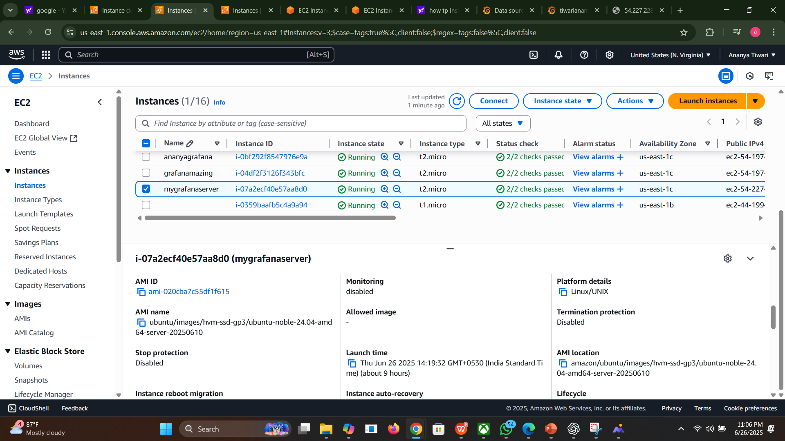
CREATING AND EC2 INSTANCE AND CONNECT IT EC2 INSTANCE :-

Slide 10
HOW TO CONNECT EC2 INSTANCE :-
TO CONNECT EC2 INSTACNCE, YOU HAVE TO CONNECT THAT INSTANCE :-

Slide 11
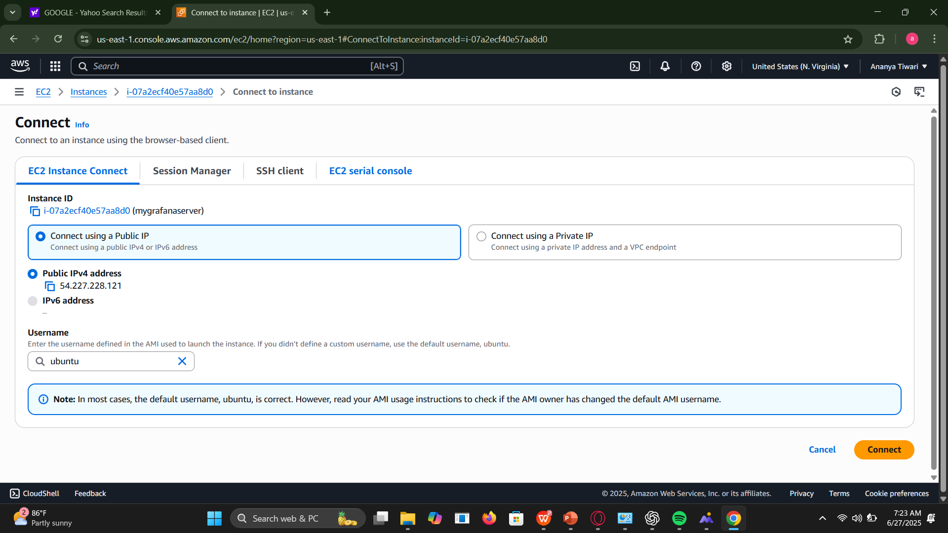

Slide 12
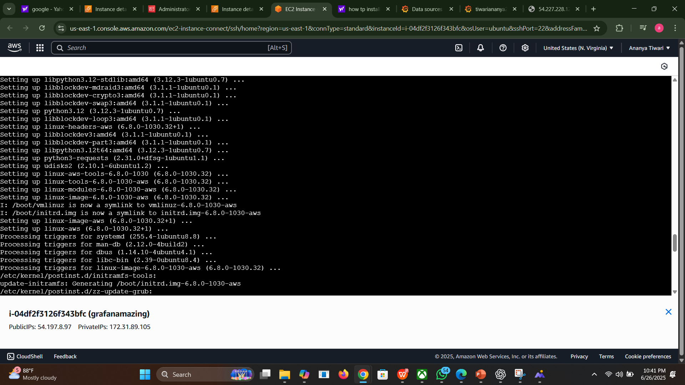
THEN AFTER CONNECT YOU HAVE TO PERFORM FOLLOWIING TASK AND RUN FOLLOWING LINUX COMMANDS :-

Slide 13
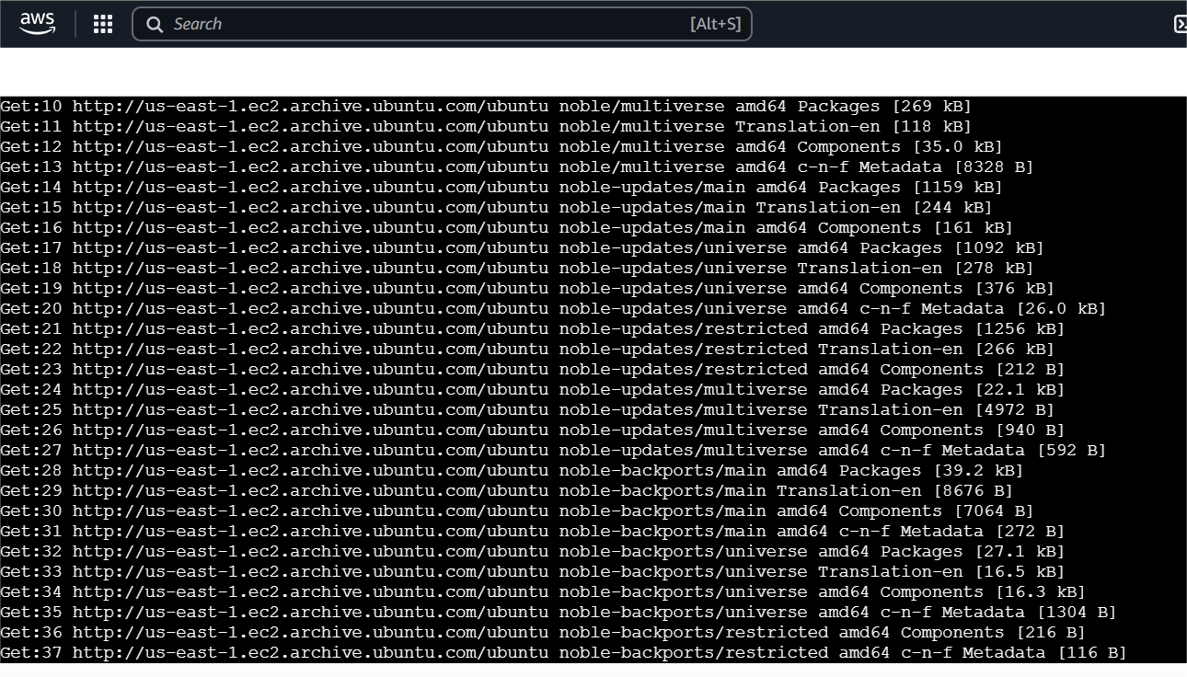
Another command to get update , sudo apt update , for upgrade :- sudo apt upgrade

Slide 14
And all the commands are here to run all commands :-
sudo apt-get install -y apt-transport-https software-properties-common wget
sudo mkdir -p /etc/apt/keyrings/wget -q -O - https://apt.grafana.com/gpg.key | gpg --dearmor | sudo tee /etc/apt/keyrings/grafana.gpg > /dev/null
echo "deb [signed-by=/etc/apt/keyrings/grafana.gpg] https://apt.grafana.com stable main" | sudo tee -a /etc/apt/sources.list.d/grafana.list
# To updates the list of available packages sudo apt-get update
sudo apt-get install grafana-enterprise
sudo systemctl start grafana-server

Slide 15
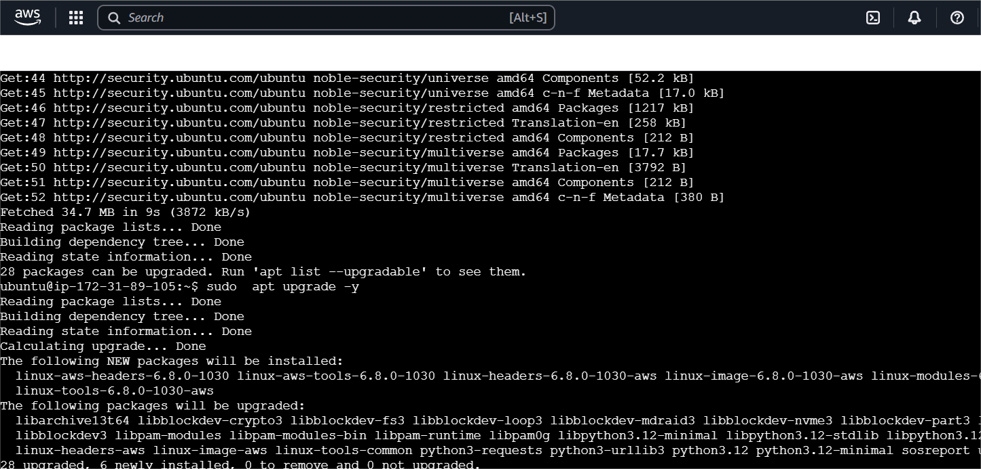

Slide 16
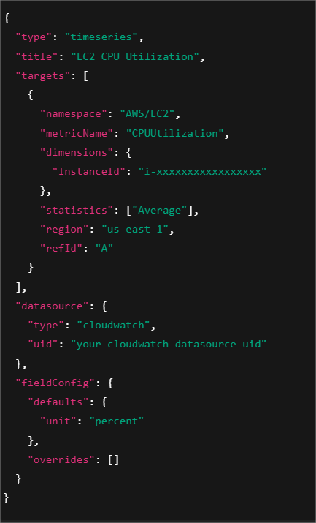
go to Iam roles and policies where you will type this code in json :-

Slide 17
Now you have to access Grafana so
Install Grafana on ec2 and then start Grafana
Sudo apt-install Grafana
And sudo start Grafana –v

Slide 18
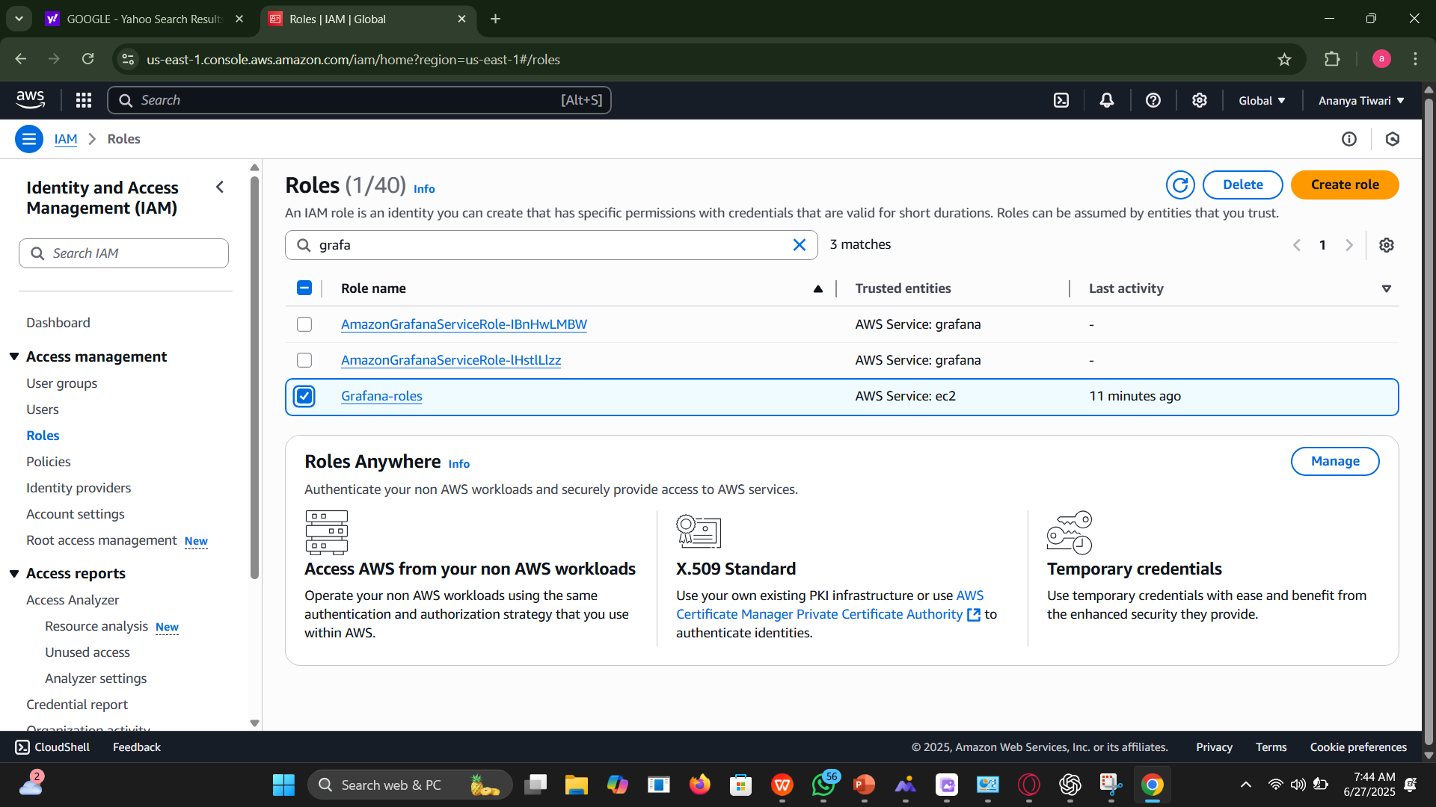
Go the iam role and then modify that role and then

Slide 19
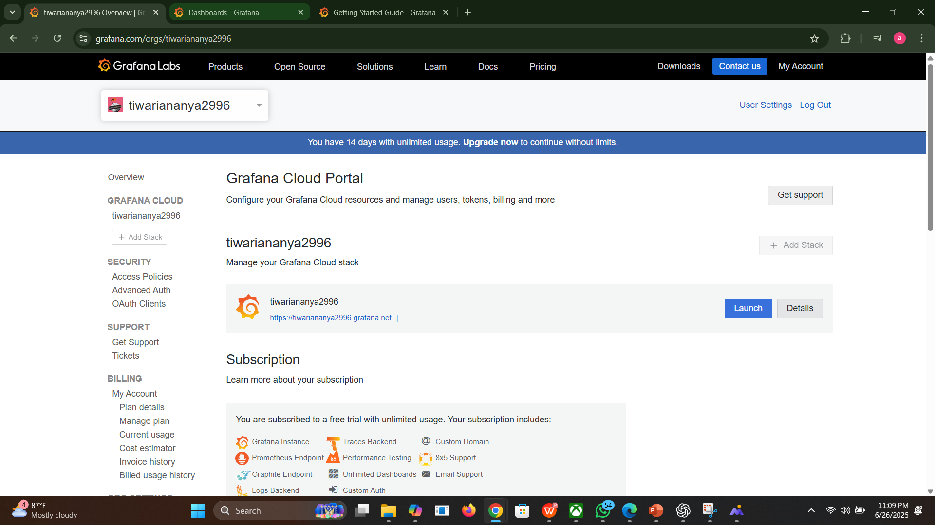
How to start Grafana :-

Slide 20
How to login it to Grafana :-
In this you can see that by log in it will be appear like this , then go to the it login it that gmail and password and then Grafana will be started and then you have to go the collection and then go the data sources and then add cloudwatch

Slide 21
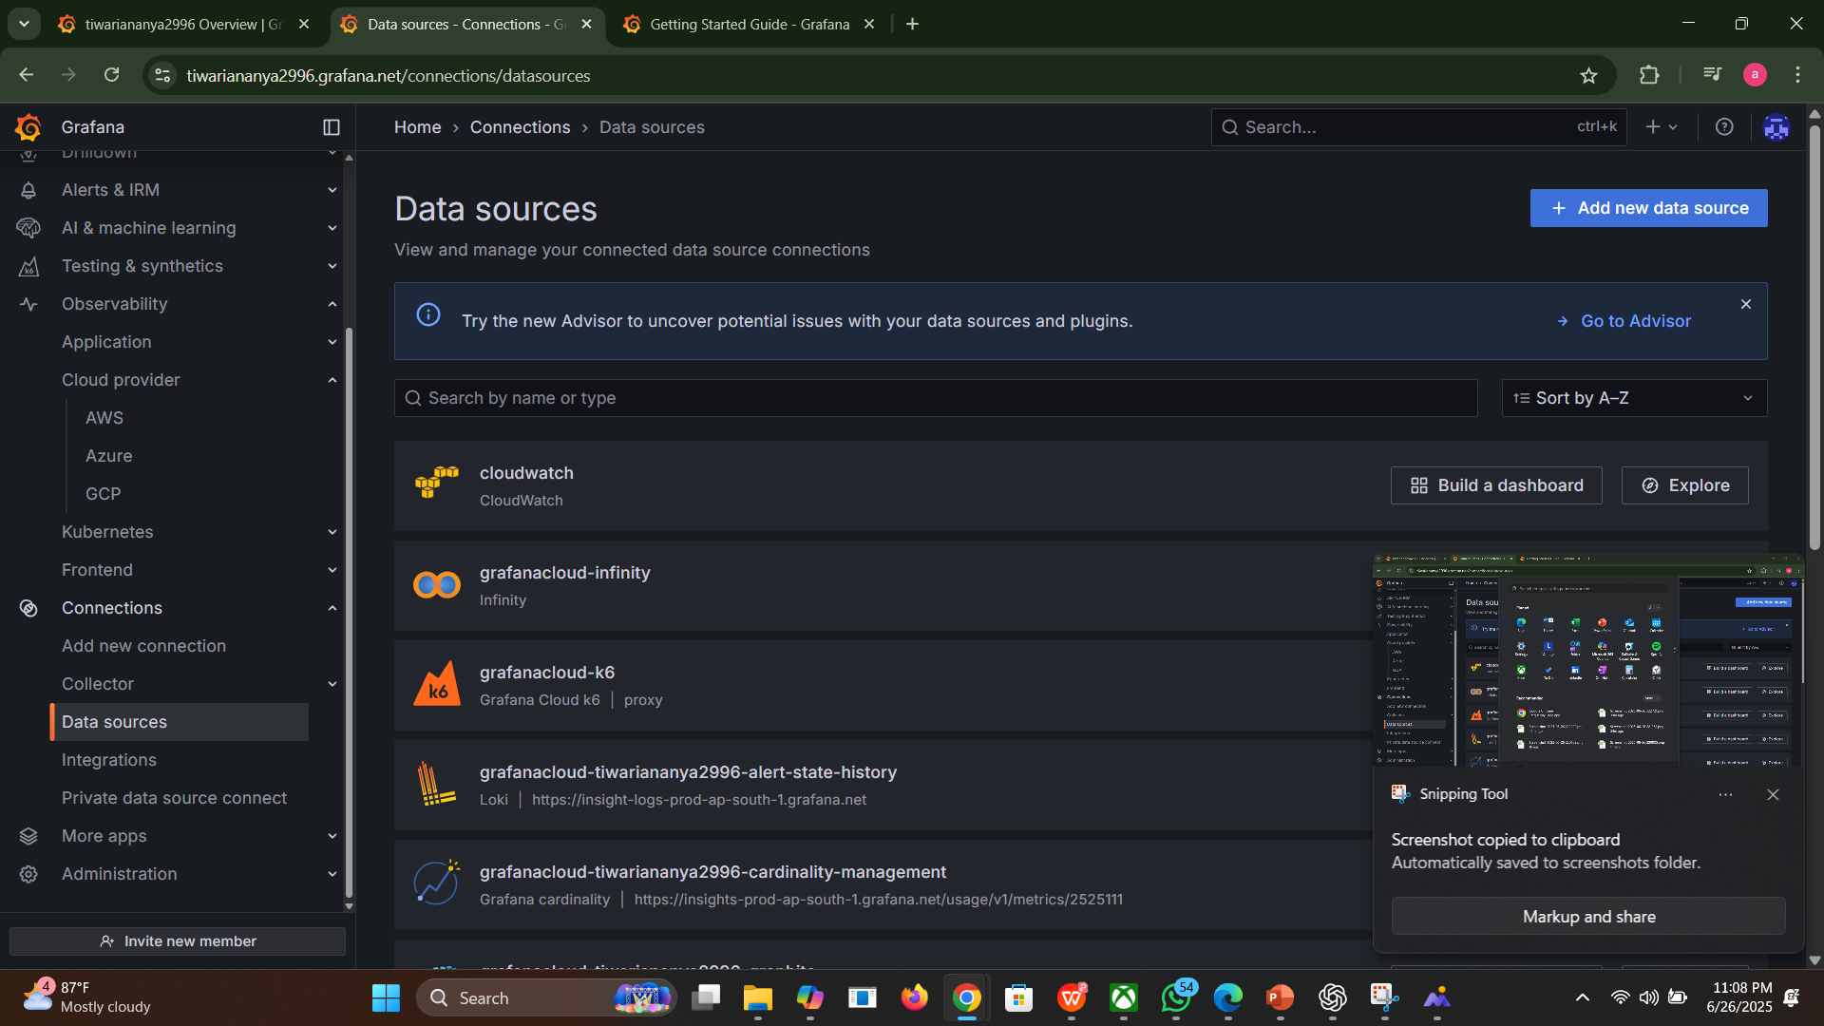
To start Grafana you have to login by username and password of the user it will be login and then go to the collection then go to the data sources and add cloudwatch and then go to the dashboard to see the graph . You can see that the graph is being created .

